Slide 1
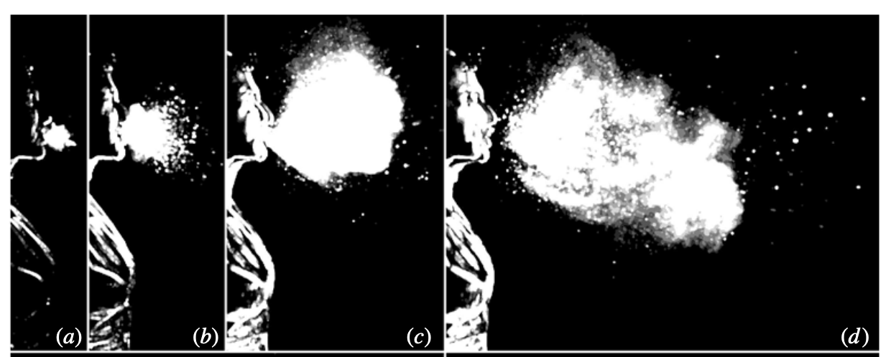
Viral fate and transport for COVID-19: A high-fidelity Multi-physics Mod/Sim Approach
Stefan P. Domino, September 23rd, 2020
Computational Thermal and Fluid Mechanics
Sandia National Laboratories SAND2020-10060 C

Slide 2
Objectives
Overview of mass, momentum, energy, and species multi-phase turbulent flow PDE/ODE set
Discretization, fluids, and Lagrangian coupling
Confidence demonstrated for unstructured multi-physics turbulent applications
High Performance Computing drivers
Established Code Credibility
Code verification
Model validation
Uncertainty quantification techniques to deploy
Case Study:
Coughs in open spaces
Coughs/breathing with and without protective shields
Conclusions

Slide 3

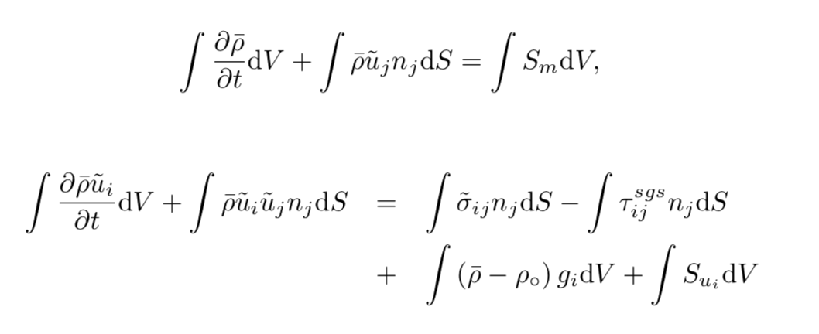
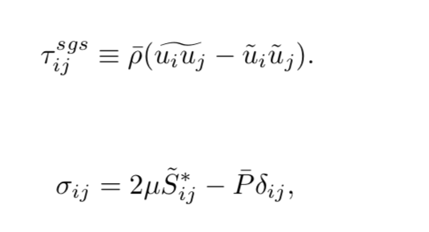
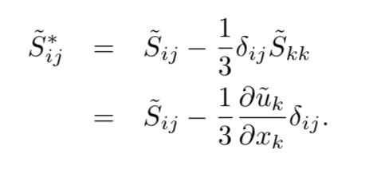
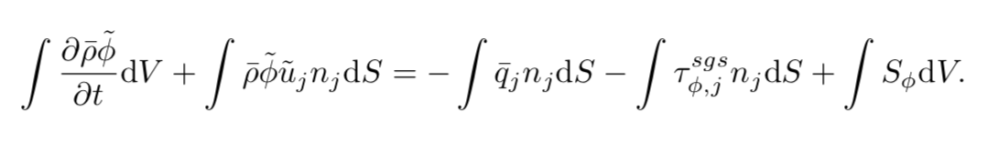
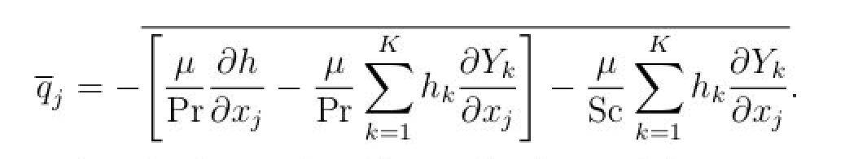
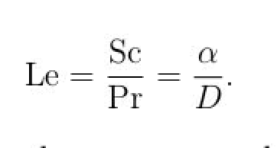
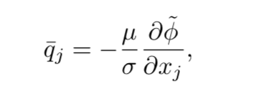
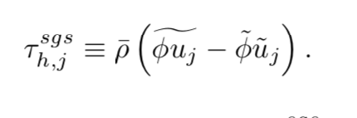
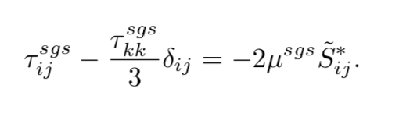
Proposed Math Model Suite (Eulerian)
Variable-density low-Mach Eulerian/point-Lagrangian multi-physics coupling
Large-eddy simulation-based (low-pass spatial filter); RANS supported, not considered
S_{k} represents coupling from Lagrangian evolution and represents source/sink of mass, momentum, energy, and species
Multiple LES models supported…

Slide 4
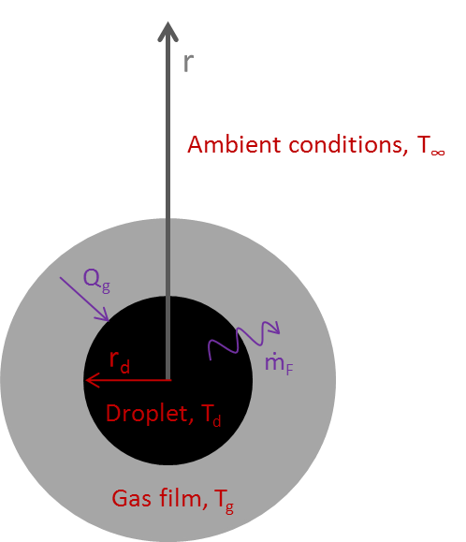
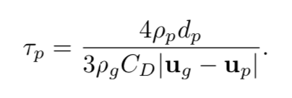
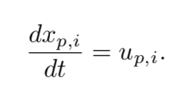
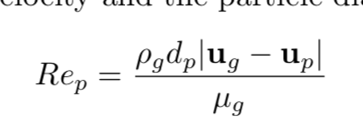
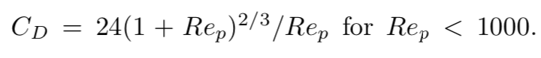
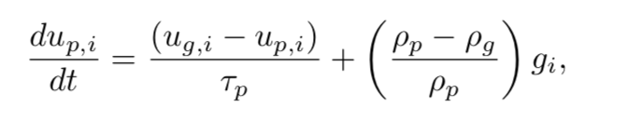
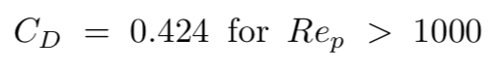
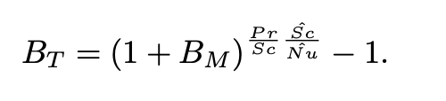
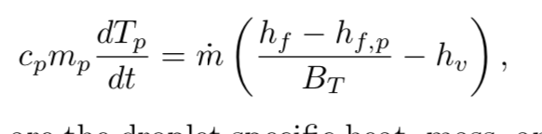
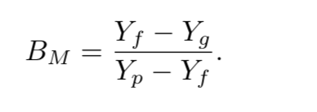
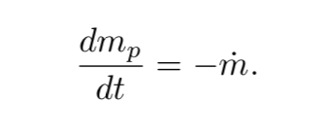
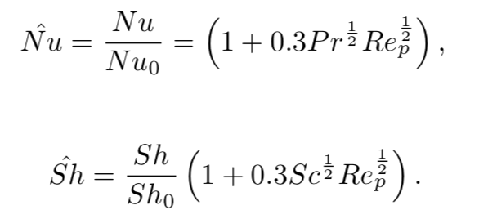
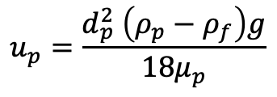
Proposed Math Model Suite (point-Lagrangian)
**
Stefan flow
Relaxation time
Spherical Lagrangian droplets
Particle Reynolds number
Circa 1950s
(Spalding, 1953)
Subgrid fluctuations
Drag coefficient; C_{D} = 24/Re_{p} provides limiting settling velocity, u_{p}
$$u_{p}=\frac{d_{p}^{2} \left(ρ_{p}−ρ_{f}\right)g}{18μ_{p}}$$
Spalding heat and mass transfer number
Raoult’s law and Clausius/Clapeyron (liquid/vapor equilibrium)
Ranz-Marshall correlation (1952)
See Fuego manual, or excellent derivation under Wikipedia: https://en.wikipedia.org/wiki/Droplet_vaporization **

Slide 5
Chosen Discretization: Control-Volume Finite Element Method (CVFEM)
A combination between the edge-based vertex-centered and FEM is the method known as Control Volume Finite Element (CVFEM) (Hex, Tet, Pyr, Wedge)
A dual mesh is constructed to obtain flux and volume quadrature locations
As with FEM, a basis is defined:
$$T\left(x_{k}\right)≈\sum_{i=1}^{npe}{N_{i}\left(x_{k}\right)T_{i}}$$
$$\frac{∂T\left(x_{k}\right)}{∂x_{j}}≈\sum_{i=1}^{npe}{{\frac{∂N_{i}\left(x_{k}\right)}{∂x_{j}}T}_{i}}$$
Integration-by-parts over test function w:
However, define a test function, w, as a piece-wise constant function (Heaviside) to be 1 inside the dual volume and 0 outside. Gradient is a Dirac-delta function:
Leading to:
A_{j}
$$\int{wρC_{p}\frac{∂T}{∂t}dV+\int{\frac{∂w}{∂x_{j}}λ\frac{∂T}{∂x_{j}}}dV−\int{w}λ\frac{∂T}{∂x_{j}}n_{j}dS=0}$$
Vol_{k}
$$\frac{∂w}{∂x_{j}}=−n_{j}δ(x_{j}−{xIP}_{j})$$
dual-volume definition
Edge-based assembles A_{j} and Vol_{k} to edges and nodes, respectively
$$\int{ρC_{p}\frac{∂T}{∂t}dV −\int{λ\frac{∂T}{∂x_{j}}n_{j}}dS=0}$$

Slide 6
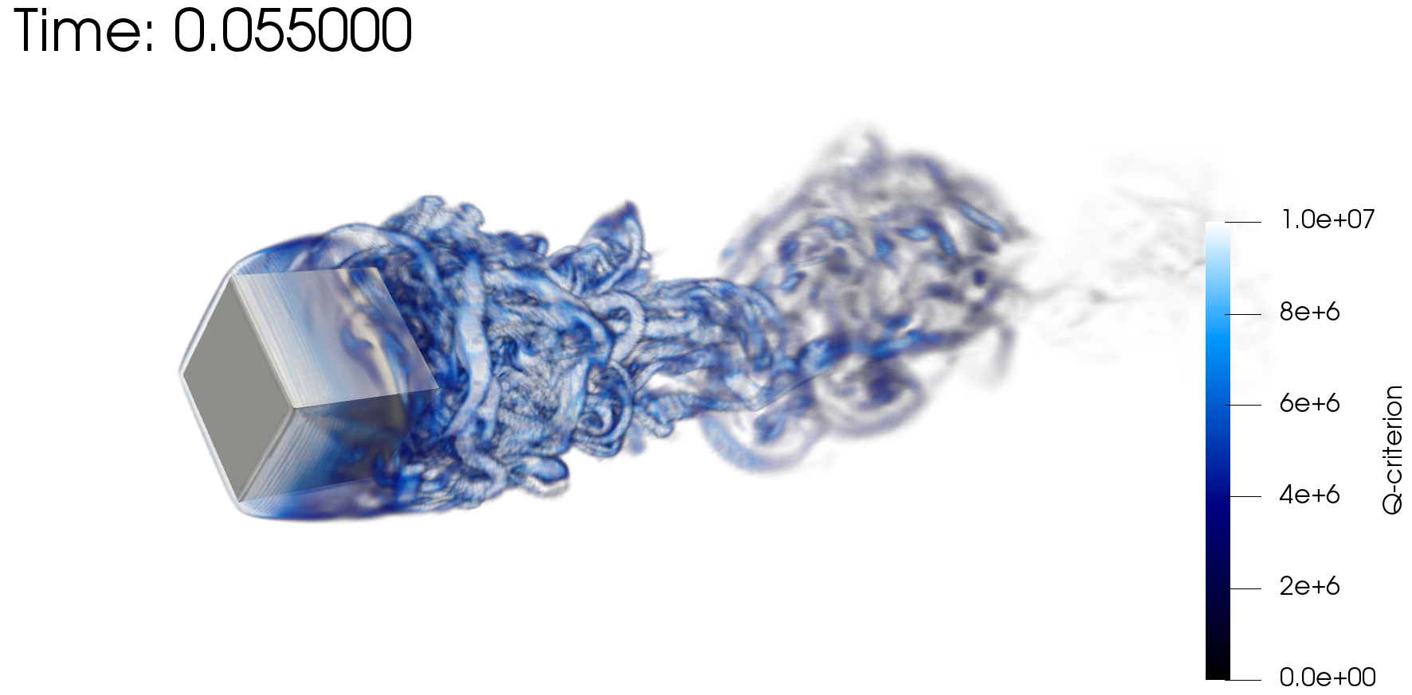
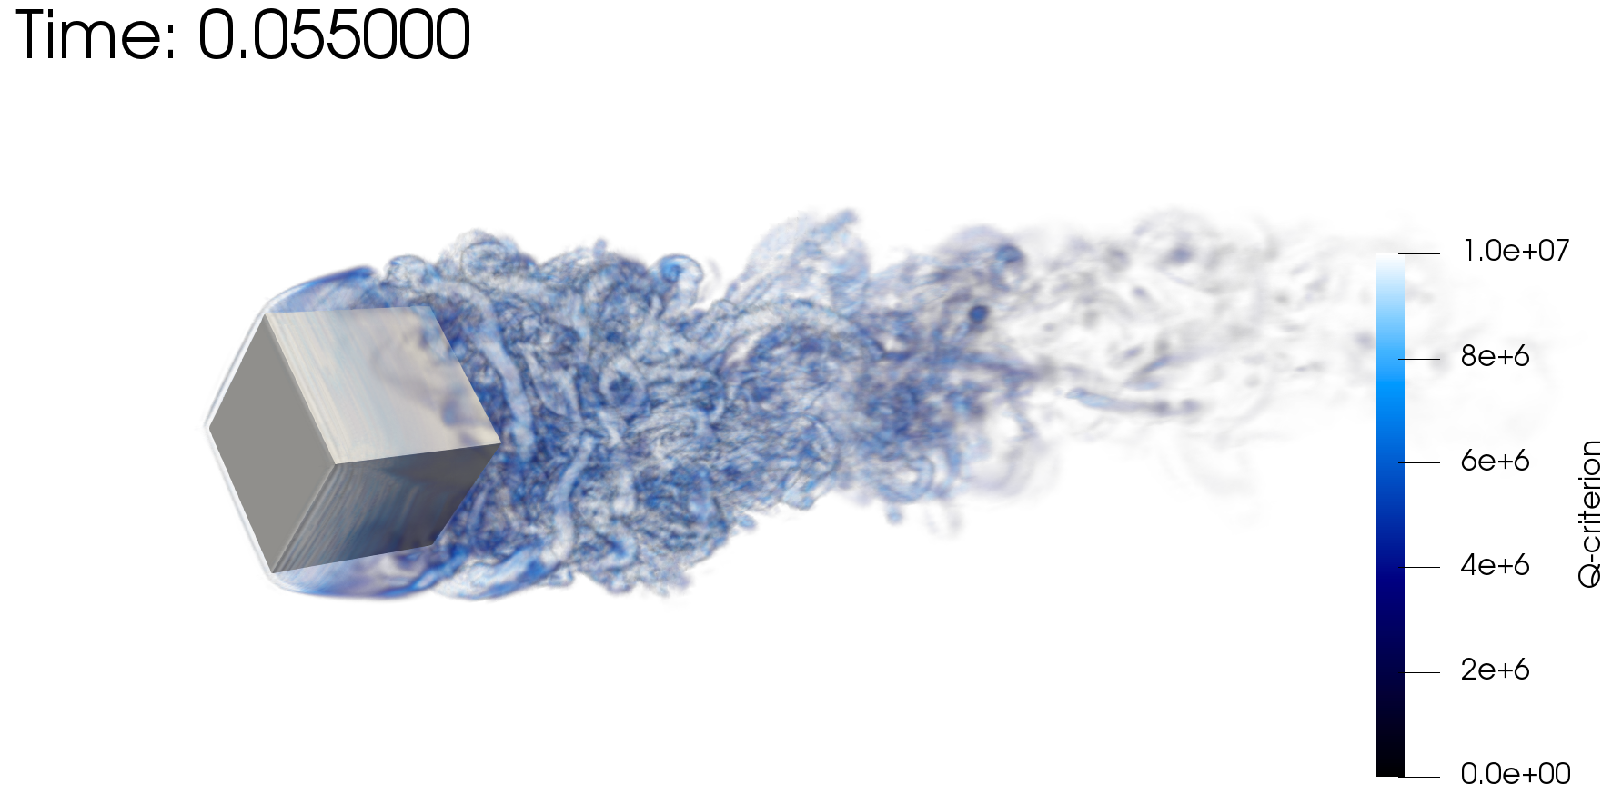

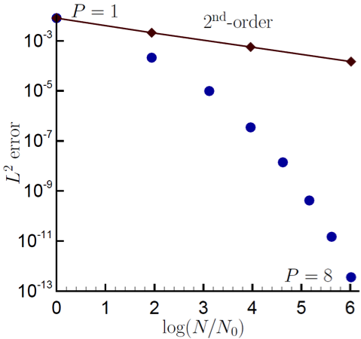
Control-Volume Finite Element Method Attributes
CVFEM can be viewed as Petrov-Galerkin method
The method can also be promoted in polynomial space, see Domino, CTRSP, 2014 as a first example of low-Mach fluids algorithm – or Domino, JCP, 2018
Research Thrust: Possible higher efficiency on NGP due to increased local work)
However, suitability of higher-order for LES is an open argument – especially when other errors/uncertainties exist
Rotating cube (Re 4000, RPM 3600)
P=1 (top) and P=2 (bottom)
Spectral convergence
Dual-volume for promoted quad4

Slide 7
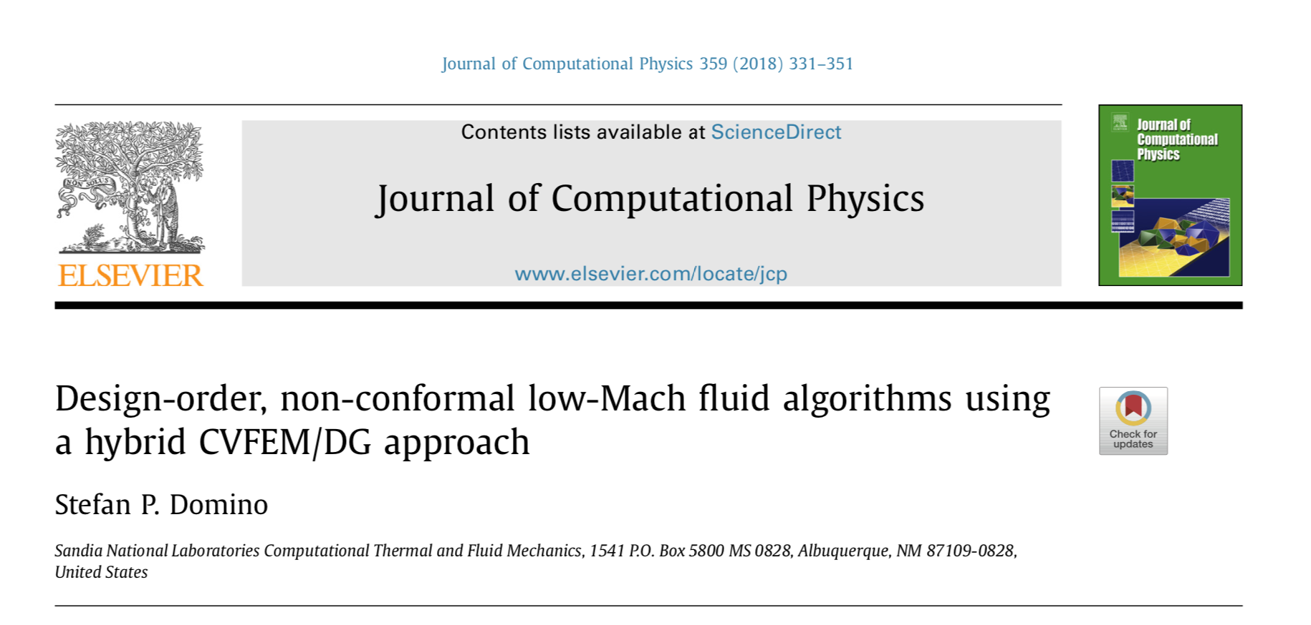
Control-Volume Finite Element Method Attributes
CVFEM can be viewed as Petrov-Galerkin method
The method can also be promoted in polynomial space, see Domino, CTRSP, 2014 as a first example of low-Mach fluids algorithm – or Domino, JCP, 2018
Research Thrust: Possible higher efficiency on NGP due to increased local work)
However, suitability of higher-order for LES is an open argument – especially when other errors/uncertainties exist
Rotating cube (Re 4000, RPM 3600)
P=1 (top) and P=2 (bottom)
Spectral convergence
Dual-volume for promoted quad4

Slide 8
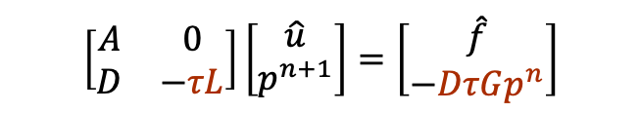


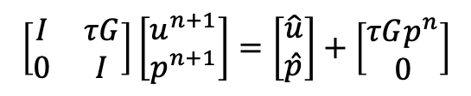
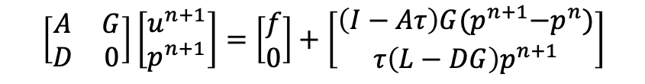

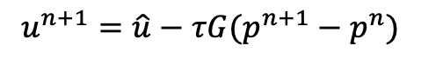
Incremental Approximate Pressure-Projection with Pressure Stabilization Errors
Let the inverse of A, A⁻¹ be approximated by B₂ as a scalar, τ (which is ~ time scale)
Let B₁ be equal to the scaled Laplace operator, - τL
The new splitting and stabilization error is given by:
The above can be shown to hold a second-order temporal error (coming)
Here, due to equal-order interpolation, i.e., collocation of primitives, L != DG
Therefore, L-DG ~ 4th-order pressure stabilization (pressure oscillations damped)
Therefore, pressure-stabilization error remains
Momentum and Continuity:
$$\left[\begin{matrix}A & 0 \\ D & −τL\end{matrix}\right]\left[\begin{matrix}\hat{u} \\ p^{n+1}\end{matrix}\right]=\left[\begin{matrix}\hat{f} \\ −DτGp^{n}\end{matrix}\right]$$
$$A\hat{u}=f−Gp^{n}$$
$$D\hat{u}=τ(Lp^{n+1}−DGp^{n})$$
Nodal Projection:
$$\left[\begin{matrix}I & τG \\ 0 & I\end{matrix}\right]\left[\begin{matrix}u^{n+1} \\ p^{n+1}\end{matrix}\right]=\left[\begin{matrix}\hat{u} \\ \hat{p}\end{matrix}\right]+\left[\begin{matrix}τGp^{n} \\ 0\end{matrix}\right]$$
$$u^{n+1}=\hat{u}−{τG(p}^{n+1}−p^{n})$$
$$p^{n+1}=\hat{p}$$
Examples:
Rhie-Chow (1983)
Peric (1985)
Fine-scale momentum residual, PSPG
$$\left[\begin{matrix}A & G \\ D & 0\end{matrix}\right]\left[\begin{matrix}u^{n+1} \\ p^{n+1}\end{matrix}\right]=\left[\begin{matrix}f \\ 0\end{matrix}\right]+\left[\begin{matrix}\left(I−Aτ\right)G{(p}^{n+1}−p^{n}) \\ τ\left(L−DG\right)p^{n+1}\end{matrix}\right]$$

Slide 9
Coupling Details
Eulerian solve is fully-implicit (BDF2); Lagrangian solve is explicit
Multi-stage stiff ODE integrator with exact or approximate (FD-based) Jacobians
For more gory details on implementation and verification, see the ASC Fuego theory manual: https://prod-ng.sandia.gov/techlib-noauth/access-control.cgi/2017/1710407.pdf
Lagrangian Advance (interpolation in time for fluids state)
x
x
x
x
x
x
x
x
Stick/pass/bounce
N
N+1
N+2
N+3
Stiff ODEs generally drive multiple steps (adaptive; minimum step count specification)
Droplet trajectory
accumulating mass, momentum, energy
Fluids Solve (allows for disparate mesh resolution)
Eulerian source terms
while (pIsActive) { itegrateInElem();
faceElemConnect();
communicate();
} load_balance();
Fluids fields
Fluids Mesh
Particle Mesh

Slide 10
Coupling Details
Eulerian solve is fully-implicit (BDF2); Lagrangian solve is explicit
Multi-stage stiff ODE integrator with exact or approximate (FD-based) Jacobians
For more gory details on implementation and verification, see the ASC Fuego theory manual: https://prod-ng.sandia.gov/techlib-noauth/access-control.cgi/2017/1710407.pdf
Lagrangian Advance (interpolation in time for fluids state)
x
x
x
x
x
x
x
x
Stick/pass/bounce
N
N+1
N+2
N+3
Stiff ODEs generally drive multiple steps (adaptive; minimum step count specification)
Droplet trajectory
accumulating mass, momentum, energy
Fluids Solve (allows for disparate mesh resolution)
Eulerian source terms
while (pIsActive) { itegrateInElem();
faceElemConnect();
communicate();
} load_balance();
Fluids fields
Fluids Mesh
Particle Mesh

Slide 11
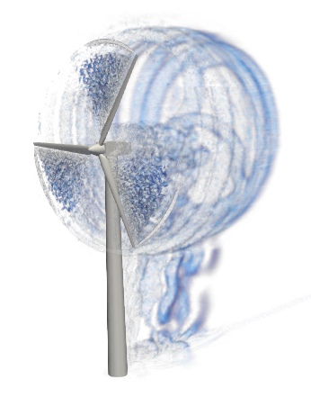

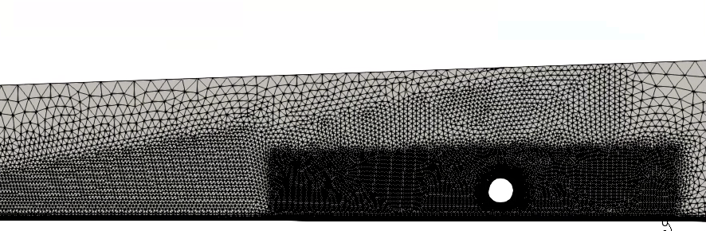
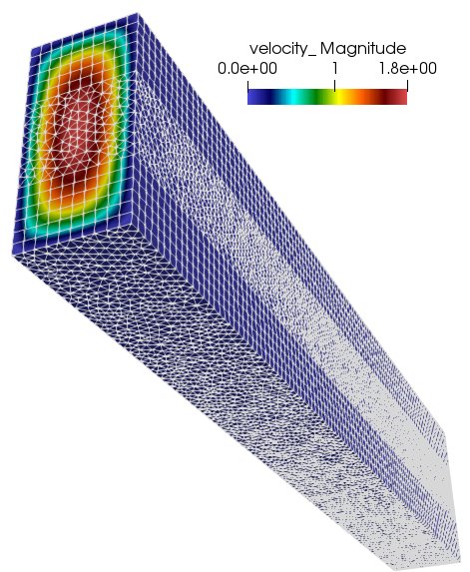
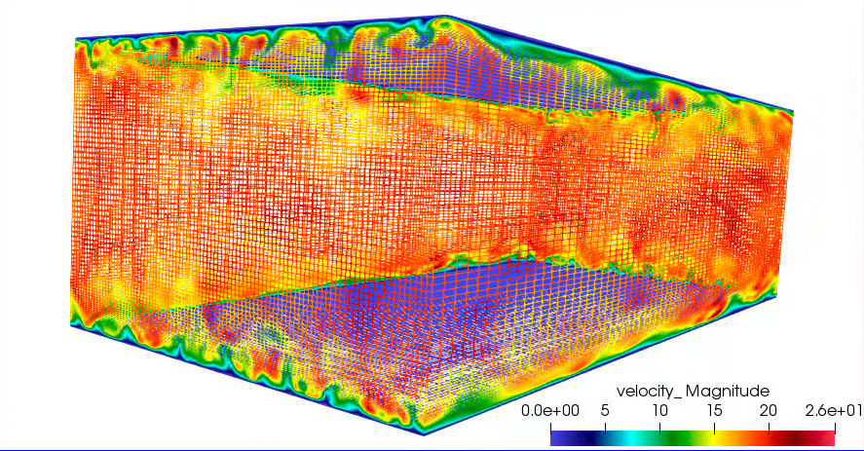
Confidence Established for Atypical Element Topos
Validation
Verification

Slide 12
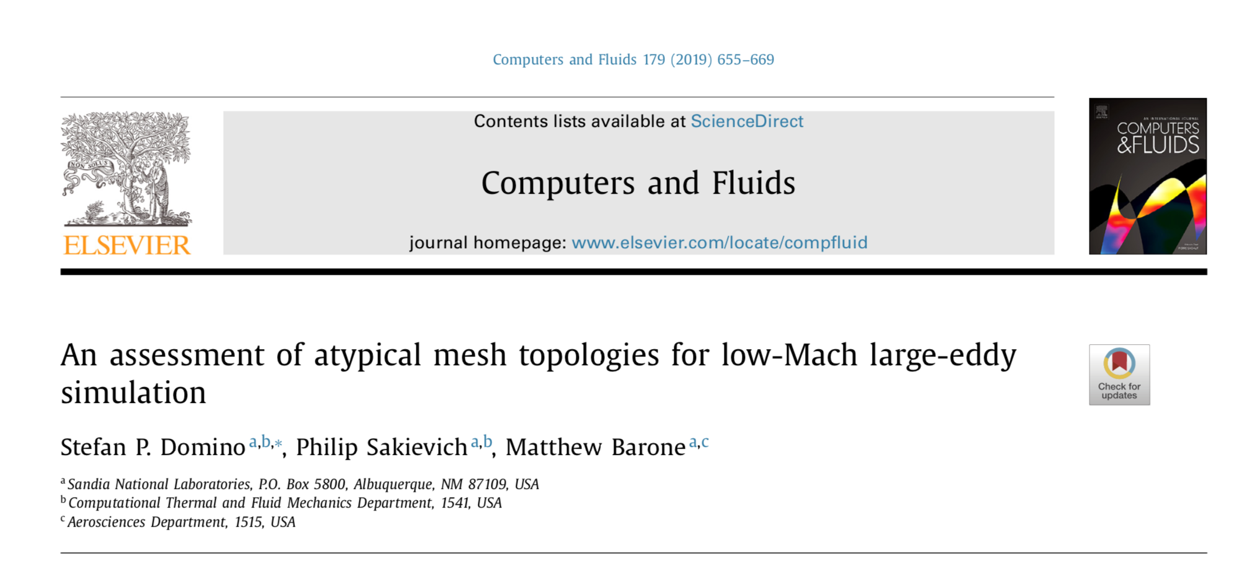
Confidence Established for Atypical Element Topos
Validation
Verification

Slide 13
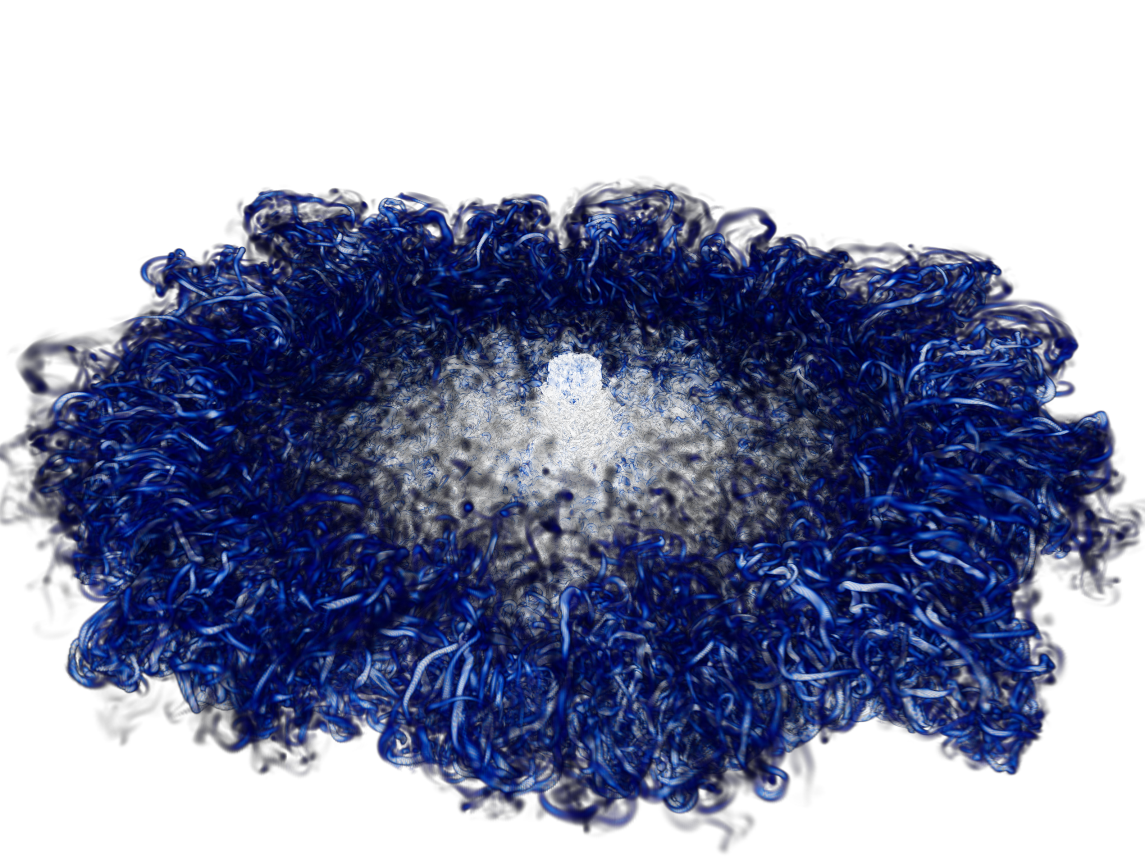
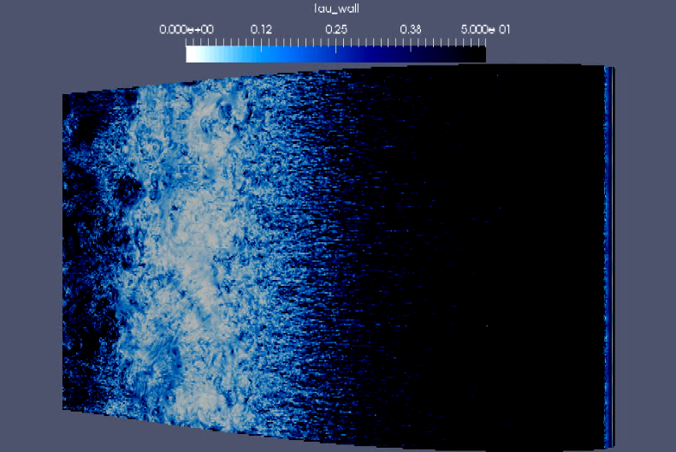
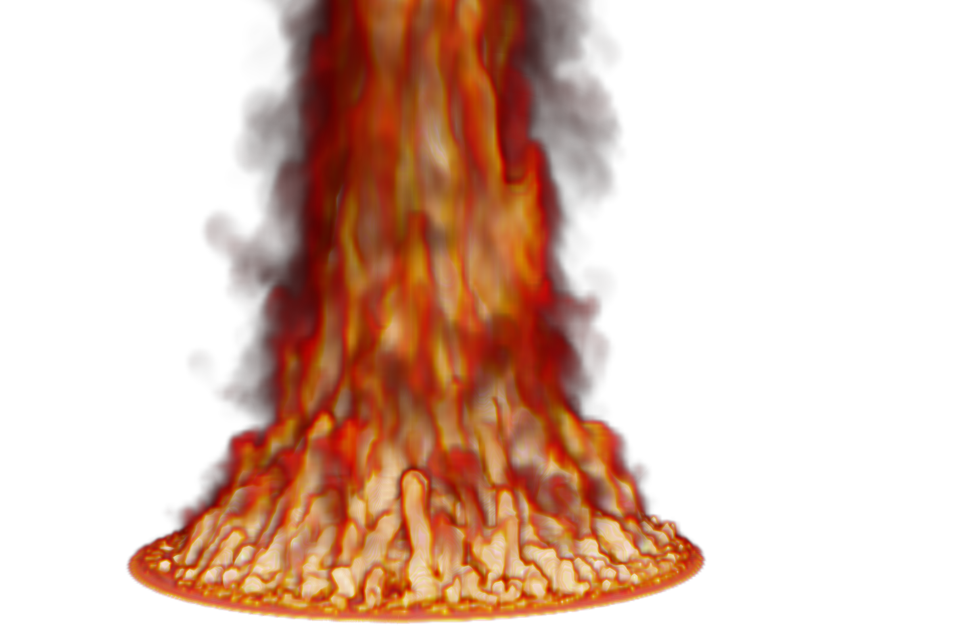
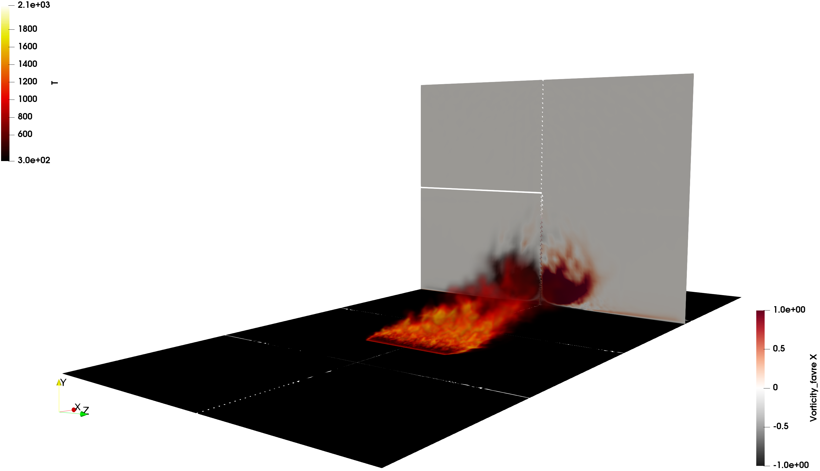

A Note on High Performance Computing
SNL is committed to High Performance Computing (HPC) to support is science and engineering objectives
O(2) billion DNS impinging jet
O(200) million multi-physics fire
O(6) billion wind energy application

Slide 14
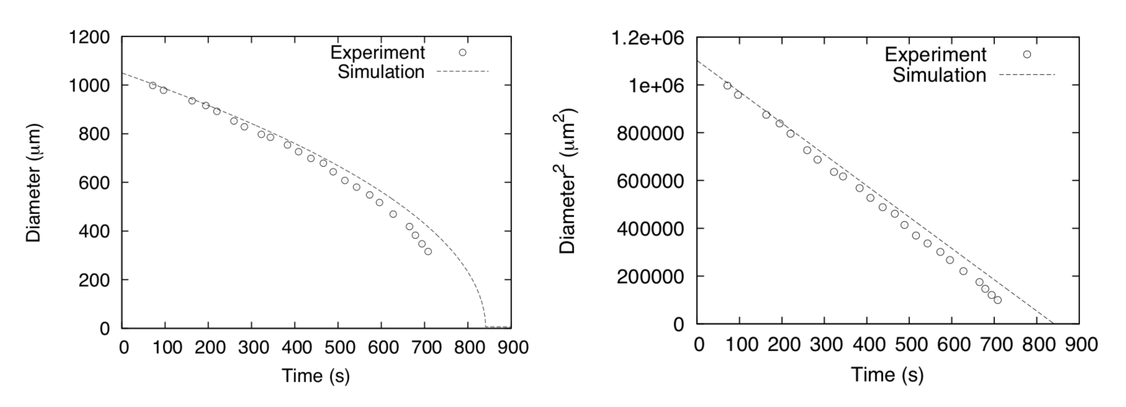
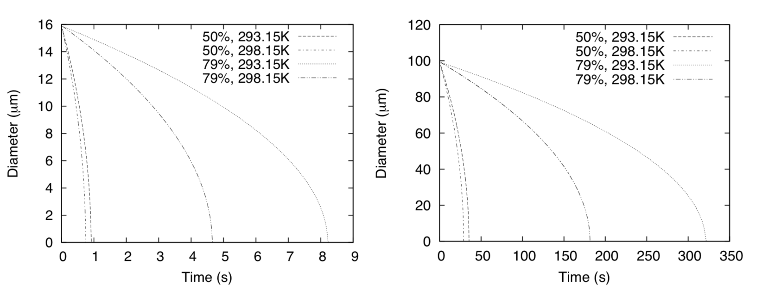
Established Code Credibility; Evaporation Model Validation
Ranz and Marshall, 1952 evaporation curves; 0% RH; See Fuego manual for verification
Validation
D² established
Exploration,
d = f(RH, Tª)
Miami vs ABQ
50%
79%
50%
79%

Slide 15
Quiescent Modeling Assumptions: To Include or Not Include: Evaporation and Coupling to Flow Field
Large droplets (> 100 μm), regardless of modeling assumptions, deposit quickly
High crosswind velocity (10 m/s and higher) can increase deposition distance
Small droplet nuclei (low-Stokes number) are highly coupled to fluid flow
Conclusions:
For O(1) scoping simulations, evaporation can probably be neglected
Droplet transport should always be coupled to carrier fluid (cough, sneeze, breathing); Eulerian source terms (generally) << small
Two-way coupling/droplet tracking is safest, especially since due to low numbers, the cost for droplet tracking is very [very] low

Slide 16
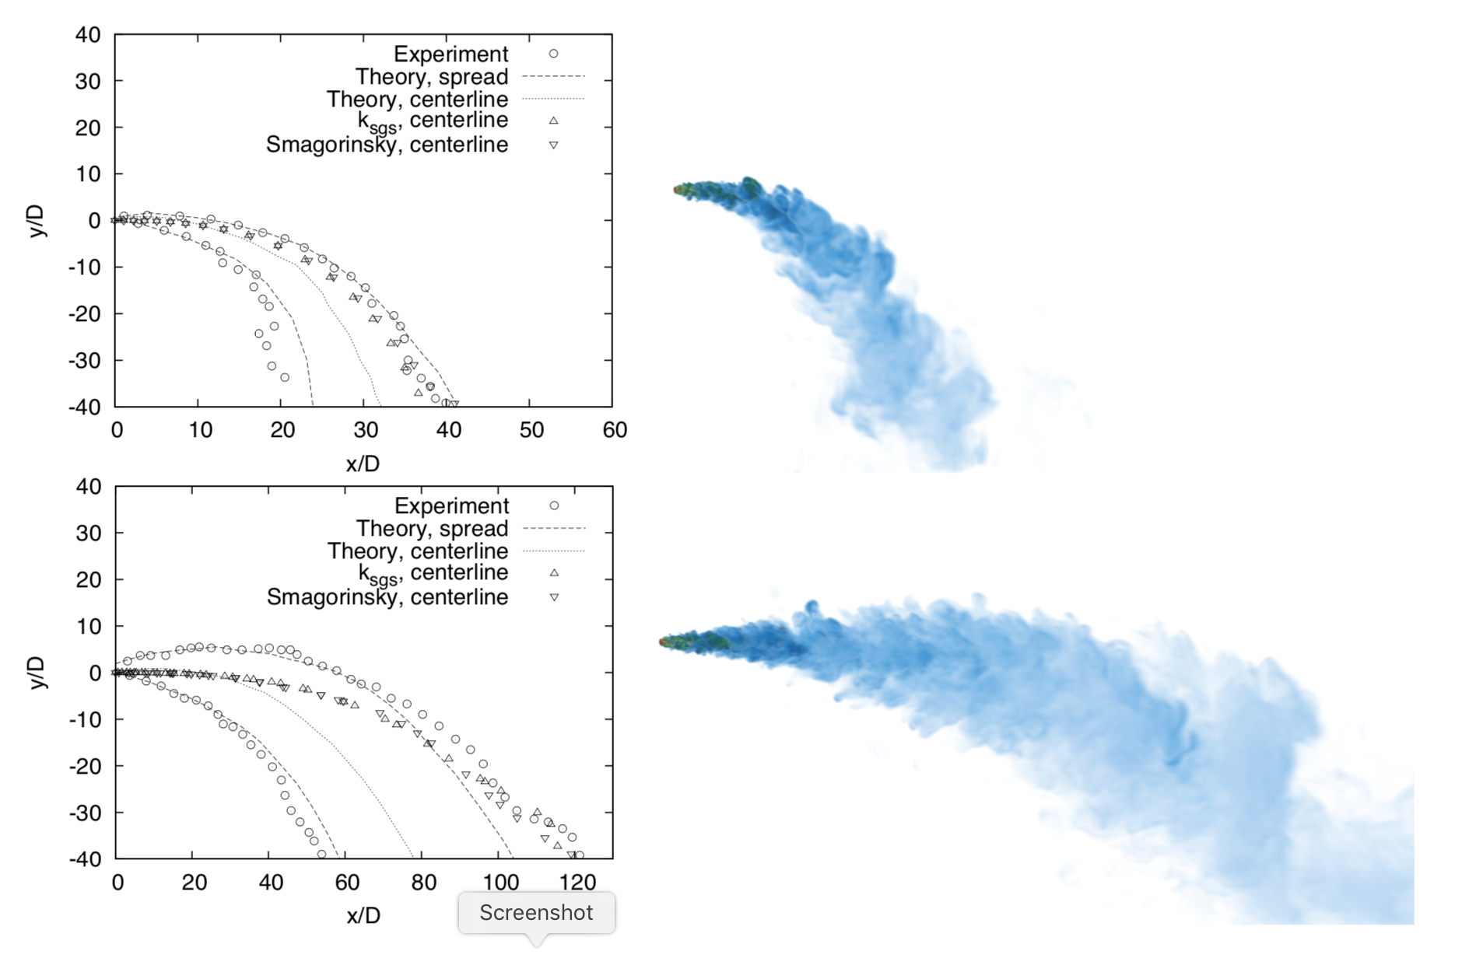
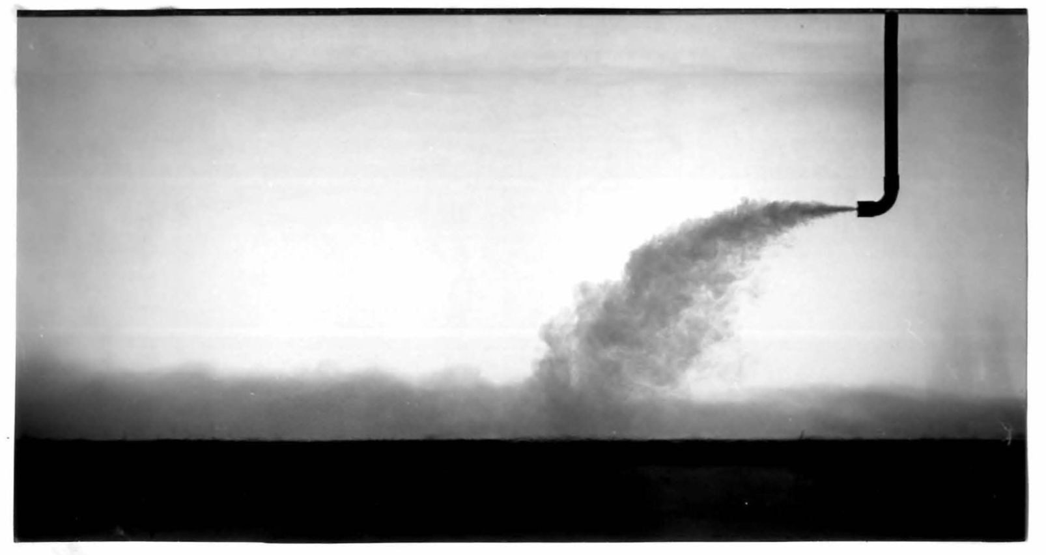
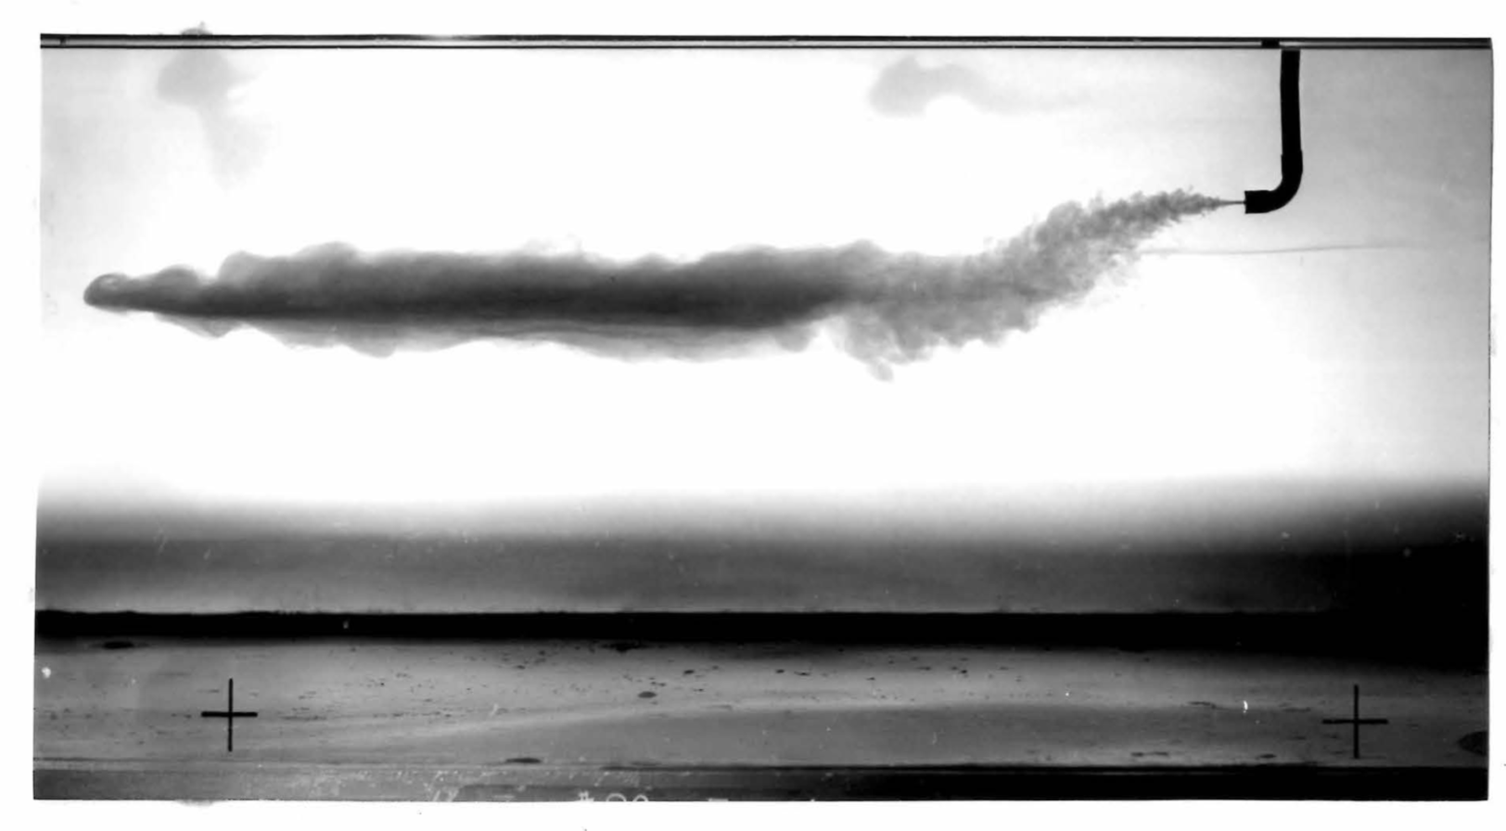
Established Code Credibility; Turbulent Fluid Mechanics
L. Fan, Turbulent buoyant jets into stratified or flowing ambient fluids, Ph.D. thesis, California Institute of Technology (1967)
LES is viable when you can resolve the flow as models are generally simplistic
Fr
Fr 10 (~breathing)
Fr 40; uniform or stratified
Fr 40 (~coughing)
Baroclinic terms small; Nicolette, Tieszen, Black, and Domino, SAND-20056273
Buoyant instabilities low; Kyle and Sreenivasan, JCP 1993

Slide 17

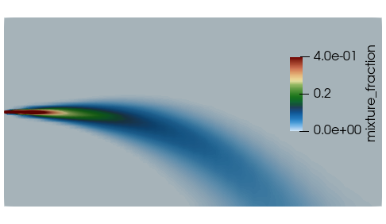

Established Code Credibility; Turbulent Fluid Mechanics
RANS vs LES?
LES (Fr 10 and 40 case, solution verification, structural uncertainty): 1e6 CPU hours
RANS (Fr 40-only case, k-e, Rm2, Rm3): 16-core for O(100) CPU hours
RANS model exercised calibrated with a suite of canonical cases, jets being one
Valid for a statistically stationary, ergotic flow, i.e., not a pulsed jet…..
See lessons learned for caveat(s) on under-resolved mesh simulations with point-Lagrangian coupling
LES
RANS

Slide 18
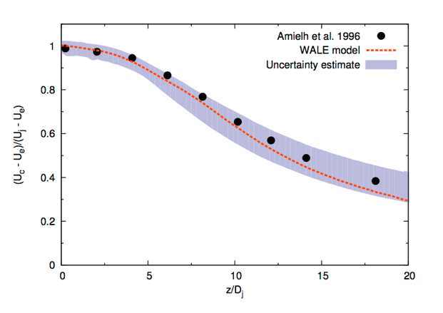
Improved VVUQ: Automatic Structural Uncertainty
Most LES validation studies establish structural uncertainty via direct model implementation and forward-calculations
Is there a more efficient approach? Yes! Eigenvalue perturbation of the SGS stress (extension of RANS-based approach: Emory et al., Phys. Fluids, 2017)
Barycentric triangle (see Lumley and Newman, J. Fluid Mech., 1977)
Open jet

Slide 19
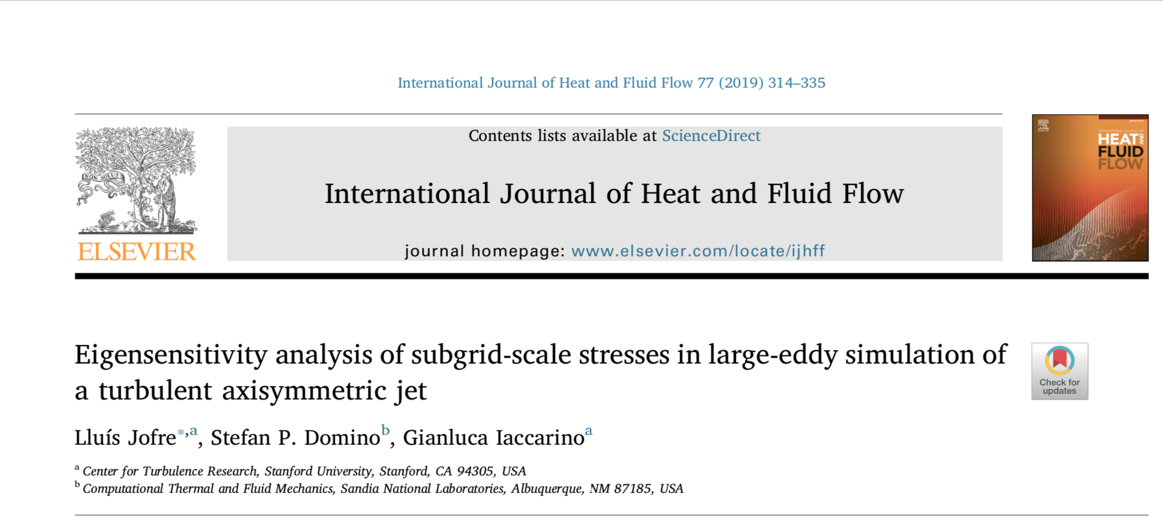
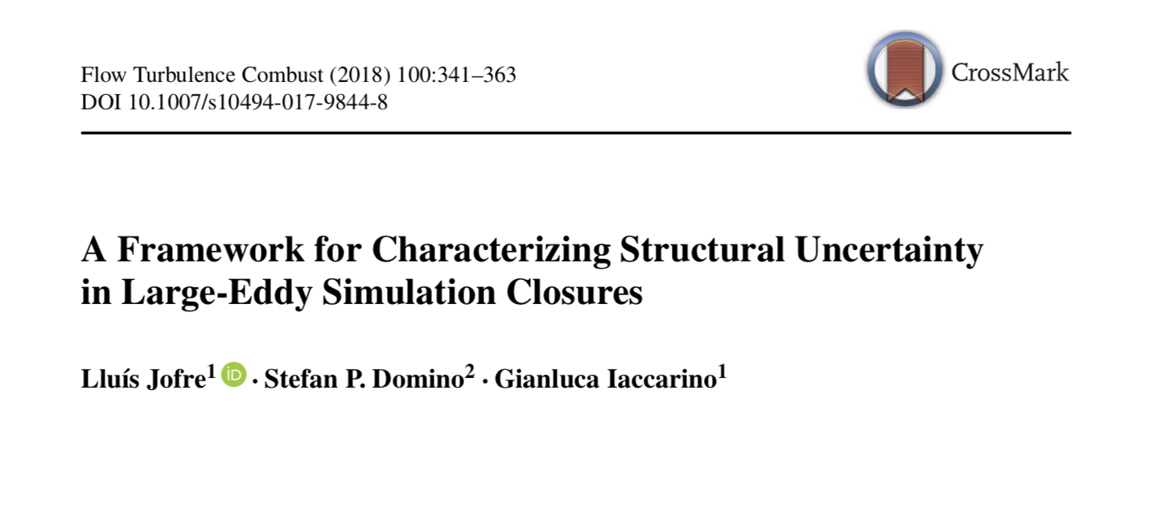
Improved VVUQ: Automatic Structural Uncertainty
Most LES validation studies establish structural uncertainty via direct model implementation and forward-calculations
Is there a more efficient approach? Yes! Eigenvalue perturbation of the SGS stress (extension of RANS-based approach: Emory et al., Phys. Fluids, 2017)
Barycentric triangle (see Lumley and Newman, J. Fluid Mech., 1977)
Open jet

Slide 20
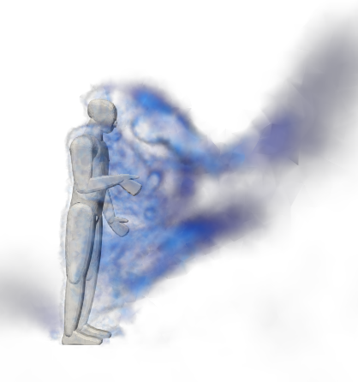





Outdoor Configurations, San Francisco, CA
10 foot circles; 8 foot separation only effective for droplets in quiescent conditions
1 m/s Crossflow direction (standing)
3.5 meters = 11’ 6”
Next-Generation Simulation mesh
0 m/s Crossflow (kneeling)
10 m/s Crossflow (kneeling)
Droplet; ~2.7 meters
Aerosol; 4.0 meters
Droplet; ~8.1 meters
Aerosol; full domain

Slide 21




Buyer-beware: low-Resolution Simulations Underpredict Vortex Shedding from Primary Jet
R0
R3
R3 ~ O(250) million elements

Slide 22


Investment in a Validation Dataset is Suggested
Current experiments are macroscopic (vs…. PIV, PLIF)
O’Hern et al., JFM, 2005
Tieszen et al., C&F 2002
Thankfully, this application does not note substantial turbulent kinetic energy production via a baroclinic mechanism (small density ratio, At# ~0.0
Lack of good finite-pulsed jet data; role for DNS?

Slide 23
Conclusions
Model Suite includes coupling between Eulerian and Lagrangian regions
Mass, momentum, energy, species multi-phase turbulent flow
Verification and Validation pedigree established for numerics/models
Credibility established for evaporating physics and buoyant jets
High-performance computing is a routine requirement
Path forward?
Moving bodies (overset)
Droplet resolved sims
DNS for pulsed flows
ML-based calibration for fast, accurate forward-based sims

Slide 24
Extra
Full talk includes more details

Slide 25


Pathogen Transport and Infection Mechanisms
Direct and Indirect transmission mechanism
Caveat: currently, the open news cycle is not distinguishing between fluid mechanics transport of droplets emanating from a cough/sneeze and the likelihood of infection by either direct or indirect transmission
As fluid mechanists, we can provide leadership towards answering the former while partnering with those who can speak towards pathogen viability and infection mechanism by providing detailed time-history trajectories
Wei and Li, A. J. Infec. Cont., 2016
Informationisbeautiful.net

Slide 26
Viability of SARS-CoV-2 Aerosols
Morris et al, “Aerosol and Surface Stability of SARS-CoV-2 as Compared with SARS-CoV-1”, New England Journal of Medicine, April 16, 2020.
The half-lives of SARS-CoV-2 and SARS-CoV-1 were similar in aerosols, with median estimates of approximately 1.1 to 1.2 hours and 95% credible intervals of 0.64 to 2.64 for SARS-CoV-2 and 0.78 to 2.43 for SARS-CoV-1
We found that the stability of SARS-CoV-2 was similar to that of SARS-CoV-1 under the experimental circumstances tested. This indicates that differences in the epidemiologic characteristics of these viruses probably arise from other factors, including high viral loads in the upper respiratory tract and the potential for persons infected with SARS-CoV-2 to shed and transmit the virus while asymptomatic.^{3,4}
Our results indicate that aerosol and fomite transmission of SARS-CoV-2 is plausible, since the virus can remain viable and infectious in aerosols for hours and on surfaces up to days (depending on the inoculum shed). These findings echo those with SARS-CoV-1, in which these forms of transmission were associated with nosocomial spread and super-spreading events,⁵ and they provide information for pandemic mitigation efforts.
Excerpt from Morris et al., 2020

Slide 27

Modeling droplet dispersion from human coughs and sneezes in complex environments
Objective: Deploy multi-physics mod/sim capability to understand droplet deposition and pathogen transport originating from human coughs to understand airborne transmission and surface contamination of COVID-19 in common public spaces
Coughs are turbulent buoyant, multiphase plumes (Re~25K for coughs)
Large droplets deposit while small droplets persist
Evaporation rates, which are environment-specific, provides understanding towards what droplets deposit and those that persists
Droplet nuclei can persist in the environment and may pose a long term risk to occupants
Bourouiba et al, JFM, 2014
Fuego synthetic cough simulation with droplet distribution from Yang et al, J. Aersol Med, 2007 including pathogen probability

Slide 28



Why Sandia?
Thermal/Fluids Core Competency rests in turbulent, buoyant, multi-phase transport
Jofre, Domino, and Iaccarino, IJHT, 2019
Domino, Sakiavich, Barone, Comp&F 2019
Domino, JCP 2018
Turbulent jets
Buoyant plumes/whirls
Deposition and suppression
Vortex dynamics
Quality unstructured numerics

Slide 29





Primary Objective: Establish a Credible High-Fidelity Multi-physics Tool
Multi-physics coughs passive breathing fluid/droplet simulations w;w/o crossflow/plexiglass
Validation for droplet evaporationRanz&Marshall, 1952; Hamey, 1982 and plume dynamics^{Fan, 1967}
Goal: Close the credibility gaps from previous COVIOD-19 work
Deploy multi-physics code capability: Sierra/Fuego low-Mach turbulent reacting flow code with point-Lagrangian coupling

Slide 30



Droplet Size Distribution; Settling Speed; Physics Description
Size, number and cough velocity are well characterized starting from as early as 1946
Variability in the literature
Settling Speed:
Buoyancy, which affects plume dynamics, are known to be significant factors
Modest room ventilation can easily suspend a droplet nuclei
Droplet Size (μm) | Settling Velocity (cm/s) | Settling Time for 2m height (s) | Evaporation Time (s)
100 | ~30 | ~6.6 | ~7
1 | ~3e-3 | ~66e3 (18.5 hr) | ~7e-4
$$m_{p}\frac{du_{p}}{dt}=\frac{m_{p} (u_{p}−u_{f})}{τ_{p}}+\left(m_{p}−m_{f}\right)g$$
$$u_{p}=\frac{d_{p}^{2} \left(ρ_{p}−ρ_{f}\right)g}{18μ_{p}}$$
Figures/Images again provided by Bourouiba et al, JFM, 2014

Slide 31


Simulation Tool Allows For Exploration of Droplet Transport in Quiescent and Crossflow Configurations
Extreme Re 50k hard cough (u = 2000 cm/s)
0.0 cm/s
100 cm/s
Crossflow direction
2.65 meters = 8’ 8”
2.1 meters = 6’ 10”
Crossflow direction
Crossflow direction
3.5 meters = 11’ 6”
100 cm/s

Slide 32








Findings: a) Droplet Nuclei Clustering/Persistence, b) Protective Shrouds are Effective for Primary Deposition Mitigation
Top wall not shown
Pulsed nominal cough jet with (Top) and without (Bottom) protective shroud; R2 mesh

Slide 33



Findings: a) Droplet Nuclei Clustering/Persistence, b) Protective Shrouds are Effective for Primary Deposition Mitigation
Plume spread for coughs and breathing

Slide 34

Findings: a) Droplet Nuclei Clustering/Persistence, b) Protective Shrouds are Effective for Primary Deposition
Top wall not shown
Re 25,000
Classic axisymmetric jet shedding drives droplet clustering
Primary droplet cloud in addition to secondary buoyant plumes

Slide 35

Findings: a) Droplet Nuclei Clustering/Persistence, 2) Protective Shrouds are Effective for Primary Deposition
Top wall not shown
Re 25,000
High- streamwise curvature impinging jet drives ring impingement clustering
Persistence of droplet nuclei is noted

Slide 36

The Role of Protective Shrouds; Passive Breathing in Zero crossflow
Wan et. al, Particle Size Concentration Distribution and Influences on Exhaled Breath Particles in Mechanically Ventilated Patients; 2014
Droplets persist while forming a concentrated cloud at the protective shroud
1, 2, and 3 micron spray distribution; 120e-12 g injection over 4 seconds; sinusoidal breath of 100 cm/s
Low velocity and small droplets render direct transmission unlikely, however, as with previous simulations, droplet nuclei persist - now at low concentrations

Slide 37

The Role of Protective Shrouds; Passive Breathing in Zero crossflow
Wan et. al, Particle Size Concentration Distribution and Influences on Exhaled Breath Particles in Mechanically Ventilated Patients; 2014
Droplets persist while forming a cloud approximately 1.5 meters from source
1, 2, and 3 micron spray distribution; 120e-12 g injection over 4 seconds; sinusoidal breath of 100 cm/s
Low velocity and small droplets render direct transmission unlikely, however, as with previous simulations, droplet nuclei persist - now at low concentrations

Slide 38

Crossflow Animations
_Pp1 = pathogen
Crossflow direction
Log-normal droplet distribution fit matching mass
1 m/s crossflow (back)

